Slide 1

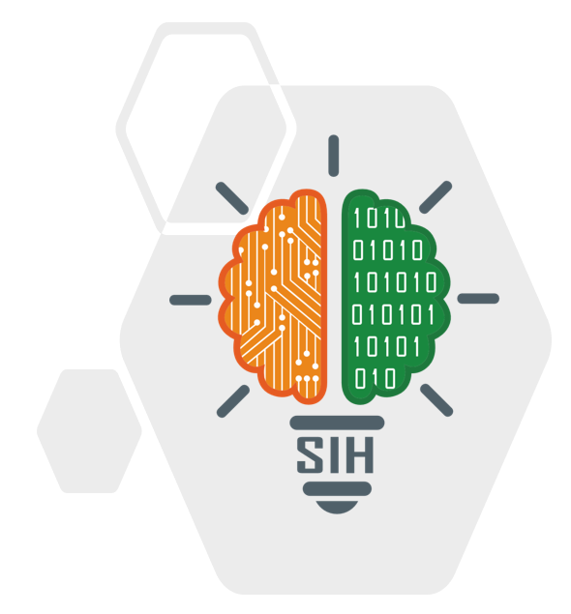


SMART INDIA HACKATHON 2026
Problem Statement ID –SIH26106
Problem Statement Title-AI-Powered Email Threat Detection, GeoLocation and Forensic Intelligence Platform
Theme- Blockchain & Cybersecurity
PS Category- Software
Team ID- 148
Team Name- Simha Raashi

Slide 2
Problem Statement & Industry Challenges
Privacy & Compliance Dilemma: Modern email security tools inspect plaintext email bodies, creating legal liabilities under GDPR, HIPAA, and CCPA. Unable to inspect end-to-end encrypted (E2EE) messages.
Sophisticated Attacker Evasion: Attackers easily mask origins using VPNs, Tor, residential proxies, and lookalike domains.Single-point indicator of compromise (IoC) lookups fail against fast-flux infrastructure.
Alert Fatigue & Manual Remediation: SOC analysts are overwhelmed with alerts; manual policy updating takes hours or days while active campaigns spread.

Slide 3
The Proposed Solution
Zero-Payload Threat Detection: Operates strictly on RFC 5322 header metadata and routing envelopes—never reads, stores, or inspects email body content.
Behavioral Digital Twins: Maintains privacy-preserving sender profiles to detect behavioral deviations.
Multi-Signal Bayesian Attribution: Fuses 8+ metadata signals to unmask VPN-backed threat actors.
Multi-Agent AI Orchestration: 4 cooperative AI agents perform forensic analysis, risk scoring, end-user explanation, and red-team evasion simulation.
Autonomous Self-Healing: Closes the loop by auto-updating firewall and anomaly policies in real-time.

Slide 4
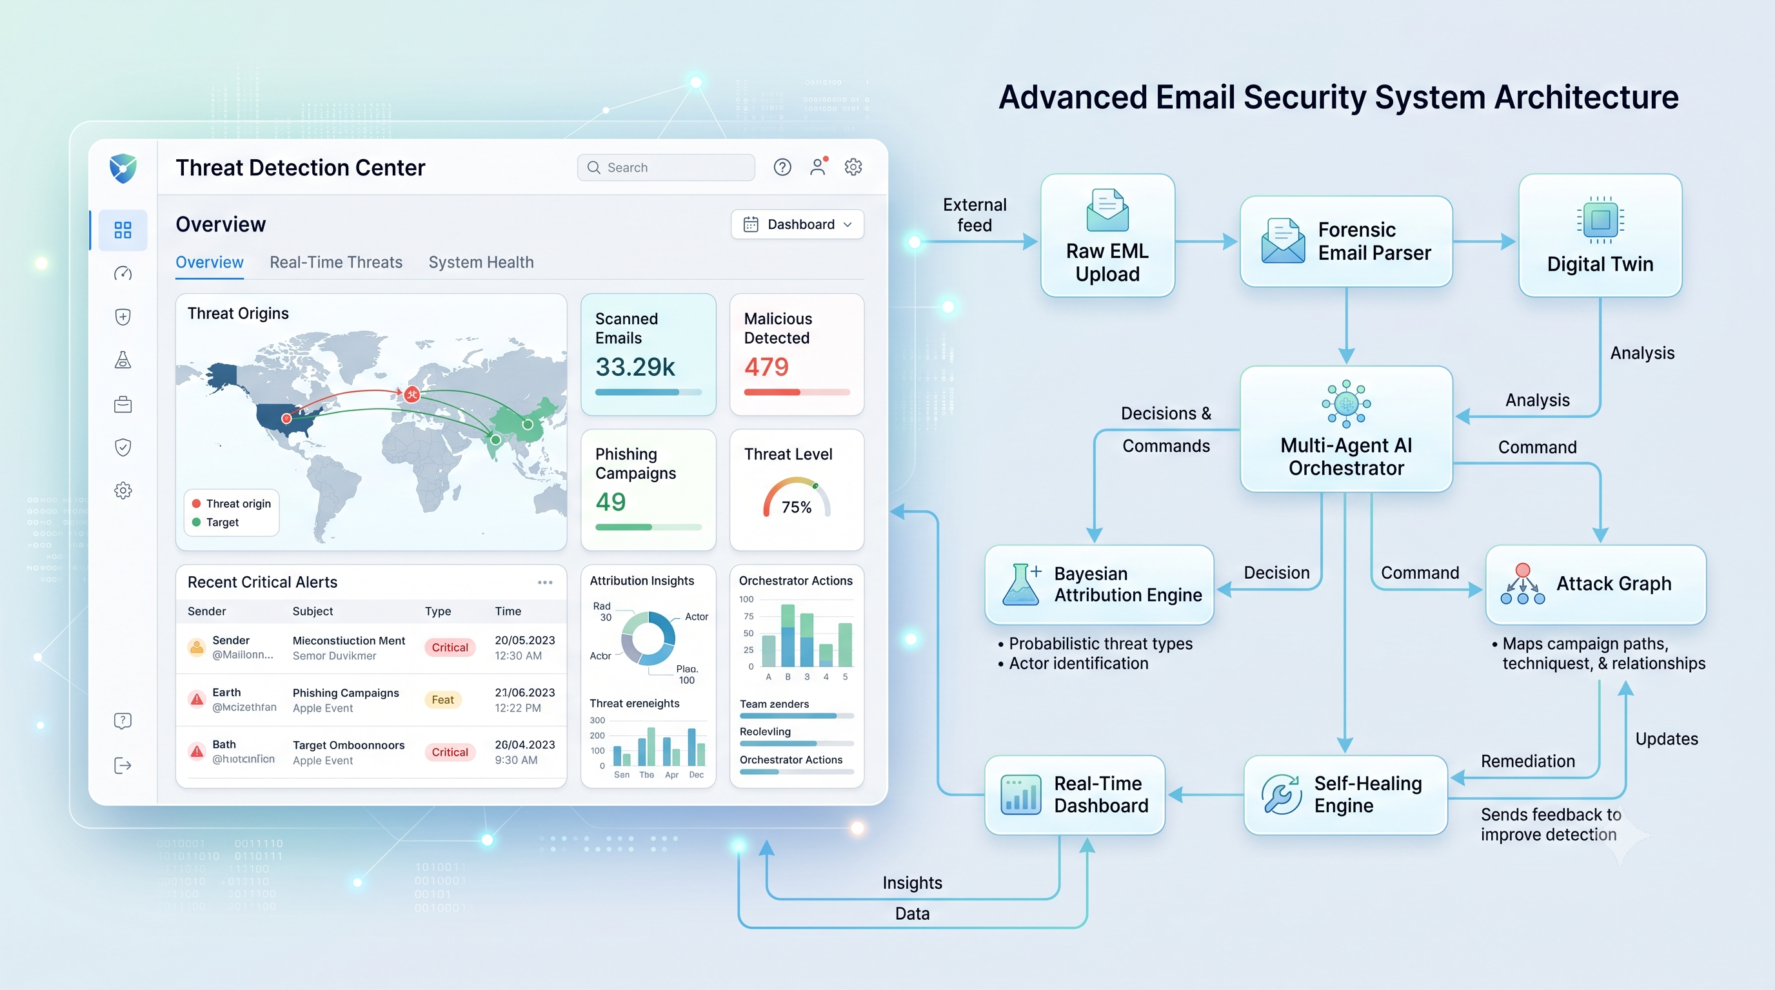
System Architecture & 6-Phase Pipeline

Slide 5
Phase 1 & 2 — Forensic Parser & Digital Twins
Phase 1 — Forensic Parser (email_parser.py):
  Extracts 30+ metadata fields: hop-by-hop Received: chains, SPF/DKIM/DMARC authentication results, ARC chains, X-Originating-IP, client User-Agents, and MIME encoding structures.
  Hard privacy constraint: MIME body parts (text/plain, text/html) are explicitly dropped.
Phase 2 — Behavioral Digital Twin (digital_twin_builder.py):
  Profiles 7 behavioral dimensions: Sending Hours (UTC), Weekday distribution, IP /24 subnet prefixes, Send frequency, Contact network (SHA-256 hashed), Domain patterns, and Charset transitions.
  Weighted Anomaly Fusion: {Anomaly} = 0.20({Hour}) + 0.15({Day}) + 0.25({IP}) + 0.15({Freq}) + 0.10({Domain}) + 0.10({Charset}) + 0.05({Subject})
  Anomaly > 0.50 Elevated scrutiny; Anomaly $> 0.70 Self-healing trigger..

Slide 6
Phase 3 — Bayesian Attacker Attribution
Defeating VPN & Proxy Evasion: A single IP geolocation is easily bypassed with VPNs. Sentinel fuses 8 independent forensic signals.
Signals Combined:
  X-Originating-IP & Relay hop IPs
  UTC Timezone offset in Date: header
  MIME Charset encoding distributions
  Domain registrar TLD & ASNs
  Inter-hop routing latency & Geographic timing
Bayesian Posterior Formulation: P({Country}/{Signals}) = P({Signals}/{Country}) * P({Country})
Result: To evade attribution, an attacker must falsify all 8 layers simultaneously rather than simply switching their proxy IP.

Slide 7
Phase 4 — Multi-Agent AI Orchestration
Sequential 4-Agent Architecture (powered by CrewAI / GPT-4 + deterministic fallbacks):
  Detection Agent (Forensic Analyst): Evaluates SPF/DKIM/DMARC, display-name spoofing, Levenshtein lookalike domains, header injection, and suspicious relay hop counts (Score 0–100).
  Risk Scoring Agent (Decision Engine): Fuses forensic score with Digital Twin anomaly score: {Risk Score} = 0.6 *{Detection} + 0.4 * ({Anomaly} * 100)$$ 0–35: ALLOW | 35–50: REVIEW | 50–75: ALERT | 75–100: QUARANTINE
  Explanation Agent (Communicator): Generates transparent, plain-English explanations for end users and non-technical staff.
  Adversarial Agent (Red-Team Challenger): Simulates bypass strategies against the current detection and feeds evasion intelligence directly to the Self-Healing engine.

Slide 8
Phase 5 & 6 — Attack Graphs & Self-Healing Defense
Phase 5 — Attack Graph Correlator (attack_graph.py):
  Built on NetworkX: Models entities (email, ip, domain, subnet, msgid_domain) as a directed graph.
  Discovers coordinated phishing waves across distributed senders via Degree and Betweenness Centrality.
  Identifies campaigns when 3$ emails share infrastructure hubs.
Phase 6 — Autonomous Self-Healing (self_healing.py):
  Eliminates human response delays through autonomous policy adaptation:
  Risk 75$ (Quarantine): Auto-appends malicious IP & domain to firewall blocklists.
  Adversarial feedback: Dynamically tightens anomaly thresholds and expands suspicious hour matrices.
  Maintains a full, tamper-evident audit log for SOC governance.

Slide 9
Technology Stack & Implementation
Layer | Technology | Purpose & Rationale
Backend API | FastAPI (Python) | High-performance asynchronous routing, OpenAPI docs
Agent Orchestration | CrewAI / GPT-4 | Multi-agent reasoning with deterministic rule fallback
Graph Analytics | NetworkX | Real-time centrality and campaign clustering algorithms
Mathematical Engine | NumPy | Vectorized Bayesian probability & anomaly z-score math
Frontend Dashboard | Next.js 14 & Tailwind CSS | Server-side rendering, responsive dark-mode cyber UI
Visualizations | D3.js & Recharts | Dynamic force-directed attack graphs and threat charts
Live Streaming | WebSockets | Sub-second telemetry push from backend to UI
Deployment | Docker Compose | Containerized full-stack deployment

Slide 10
Experimental Results & Dataset Benchmark
Metric | Measured Value
Total Ingested Emails | 7,446 emails
Successfully Processed | 6,741 emails (90.53%)
Processing Throughput | 16.1 emails / second (461s total runtime)
Average Decision Latency | 1,238 ms per email
Coordinated Campaigns Detected | 4,644 campaigns
Decision Breakdown | 98.7% REVIEW, 1.2% ALLOW, 0.1% ALERT
Key Takeaways:
  Accurately categorized 98.7% of suspicious samples for human-in-the-loop review.
  Successfully grouped disparate emails into 4,644 correlated campaigns through shared relay nodes and domains.

Slide 11
Privacy & Security Architecture
Strict Privacy by Design:
  No email body, attachment payload, or message text is ever parsed, decrypted, or stored.
  Compatible with transparent MTA-level proxies and end-to-end encrypted email systems.
Data Minimization & Anonymization:
  Recipient and contact networks stored solely as SHA-256 one-way hashes.
  IP addresses coarsened to /24 CIDR blocks to prevent user location tracking.
Enterprise Ready: Full compliance alignment with GDPR (Article 5 & 25), HIPAA, and CCPA.

Slide 12
Limitations & Future Roadmap
Current Limitations:
  Cold-Start Window: Digital Twins require ~20 baseline emails to reach optimal confidence.
  Parser Edge Cases: 9.47% malformed RFC-noncompliant headers produced parse errors.
Future Roadmap:
  Adaptive MIME Parser: Self-recovering fallback parsers for corrupted headers.
  Federated Digital Twins: Cross-organization threat intelligence sharing with differential privacy.
  Explainable AI (XAI): SHAP-value feature attribution overlays for SOC analysts.
  Native Client Integrations: Direct plugins for Microsoft 365, Google Workspace, and Thunderbird.

Slide 13
Conclusion & Key Highlights
Key Takeaways:
  High-Accuracy Without Spying: Proved email headers provide ample telemetry for threat classification without touching message bodies.
  Intelligent Attribution: Bayesian multi-signal fusion overcomes VPN and proxy obfuscation.
  Autonomous Resilience: Multi-agent reasoning coupled with self-healing rules shrinks incident response time from days to milliseconds.
Open Source Repository: github.com/saiakkala2006/sentinal

Slide 14
Q&A
Questions & Discussion
Thank you!

